Slide 1
Welcome

Slide 3
What is your expectation?

Slide 4
What is my expectation ?

Slide 5
Some Promises

Slide 6
Promises
1. Attendance
2. Interactive
3. Honesty
4. Revise everything before next class
https://www.meritnation.com/blog/9-tips-on-how-to-revise-your-course-effectively/

Slide 7
How to learn anything ?

Slide 8
What, Why and How
Learning Methodology

Slide 9
Course Walkthrough

Slide 10


Slide 11
What is Internet ?

Slide 12

Web Browser and Its power ?

Slide 13
It’s also just software.
Used for layout or render something on screen.
Static Websites
Dynamic Websites
Chrome Dev Tools

Slide 14
Static Websites
Wikipedia, School & College Websites etc
Easy to build
Fast access
Weak Security
Used for showing static data or kind of permanent data
Build using simple HTML and CSS

Slide 15
Dynamic Website
Twitter, Facebook, Youtube, Edyoda
Comparatively to hard to build,
Slow access compare to Static Websites
High Security
Build on Client Server and database model.

Slide 16
Two Types Software Developer
Frontend Developer
Backend Developer

Slide 17
How to write and design something on client ?

Slide 18
HTML & CSS

Slide 19
Best thing about HTML
Easy to learn
Fun to learn
How many days it takes to become an expert in HTML ?

Slide 20
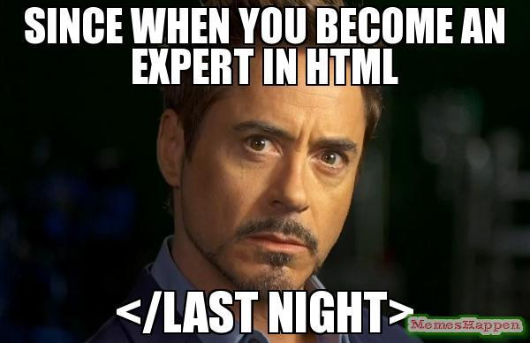

Slide 21
What is HTML ?
Hyper Text Markup Language (NOT Programming Language)
Used for create and structure our web pages.
Used to create skeleton for the web pages.
Everything on web is somewhere HTML.
Let’s check some demo. ( Check View Source Page )

Slide 22
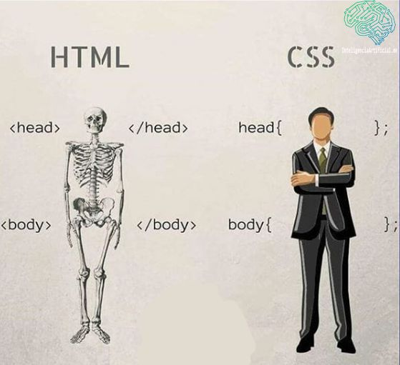

Slide 23
Let’s Write our first HTML Code
Hello world Code

Slide 24
But where do we write our code
https://code.visualstudio.com/download

Slide 25
Rules For Writing HTML Tags
HTML uses markup tags to describe web pages.
Tags like ex:- <someTag> </someTag>.
They are called as start and end tags.
Start tag is also called opening tag.
End tag is called Closing tag.

Slide 26
Check Community Threads for more info

Slide 27
Block and Inline Elements
A block-level element always occupies the entire available width (stretches out
to the left and right as far as possible).
An inline element only uses the space that is required.

Slide 28
CSS - Cascading Style Sheets
It's basically used to create good-looking websites by describing how the HTML
elements are displayed on the screen.
CSS
helps web developers to style the website so that the users can have a great user experience.

Slide 29
How to CSS into HTML file?
Inline CSS
Internal CSS
External CSS

Slide 30
Inline CSS
By using the inline CSS approach, CSS can be applied to a single element.
You can quickly and easily insert CSS rules into an HTML page.
Stupid way ( Can’t reuse it )

Slide 31
Internal CSS
The internal CSS is used to add a unique style for a single document.
It is defined in <head> section of the HTML page inside the <style> tag.
IDs and classes can be used in internal style sheets.

Slide 32
CSS Selectors Part (1)
id (#) and class (.)

Slide 33
Id (#)
An ID allows developers to identify a single element in the HTML code and apply a particular style to it.
Selects a single element.
Is written with a hash symbol followed by the ID name.
Example : -
#heading1 {
text-align: center;
color: green;
}

Slide 34
Class (.)
You should use a class if you need to use the same CSS more than once within a page or a site.
Classes can be assigned to multiple elements.
Classes are denoted by a period, followed by the class name.
Example : -
.center {
text-align: center;
color: green;
}

Slide 35
Priority of CSS in the file
Determines which styles will be applied to an element

Slide 36
Order of priority
Inline CSS > Internal CSS > External CSS

Slide 37
Shortcuts with Emmets
https://emmet.io/

Slide 38
Emmet is a plugin for many popular text editors which greatly improves HTML & CSS workflow.
Lots of shortcut using Emmets.
Use !
To Setup HTML/CSS boilerplate code
Use p[style="color:red"]
<p style="color:red"></p>
Use p{hello and welcome all}
<p>hello and welcome all</p>

Slide 39
Use div*3
<div></div>
<div></div>
<div></div>
Use ol>li*3
<ol>
<li></li>
<li></li>
<li></li>
</ol>
Use div>div>pre>a
<div>
<div>
<pre>
<a href=""></a>
</pre>
</div>
</div>

Slide 40
INTRO HTML5

Slide 41
HTML 5 = Old HTML + New Features

Slide 42
Pros of HTML
Easy and simple to use.
The standard language for structuring our web pages.
Free to use. No Charges.
Supported by every browsers.

Slide 43
Cons of HTML
Only used making static web pages.
No syntax error detection.
Zero Security

Slide 44
New features in HTML 5
Many attributes added in HTML5 for different use cases.
Added support for audio, video, and other multimedia content by using tags like <audio>,<video>, etc.
HTML5 supports Search Engine Optimisation(SEO).
Introduced Semantics Tags

Slide 45
Semantic Tags
Self Explanatory Tags

Slide 46
Semantic Tags
Semantic tags are used to add more meaning to the
webpage.
They improve readability and maintainability of HTML code.
SEO becomes easy and better.

Slide 47
<header></header>
<main></main>
<footer></footer>
<nav></nav>
<details></details>
And more…..

Slide 48
Entities
Entities are used to display reserved characters in HTML.

Slide 49
Complete list of entities
https://www.freeformatter.com/html-entities.html

Slide 50
Input Tags
Allows user to input data

Slide 51
Example of Input Tags
<input type="text">
<input type="number" >
<input type="email" >
<input type="password" >
<input type="date" >
<input type="color">
<input type="time" >
<input type="checkbox">
<input type="submit">
<input type="radio" name="GENDER" id="">

Slide 52
Label Tags
Represents a caption for an item in a user interface.

Slide 53
Example for Label Tag
<label for="firstName">FirstName</label>
<input type="text" id="firstName">

Slide 54
Form Tag, FieldSet Tag, Legend Tag
method = “get” or method = “post”
Action = “/backendPage.js”

Slide 55
Agenda - Class 28 April 2023
1. Revise or Recap of last class
2. Box Model
3. Padding, Border & Margin
4. Use google fonts
5. Student Signup Form & Hover Effect

Slide 56
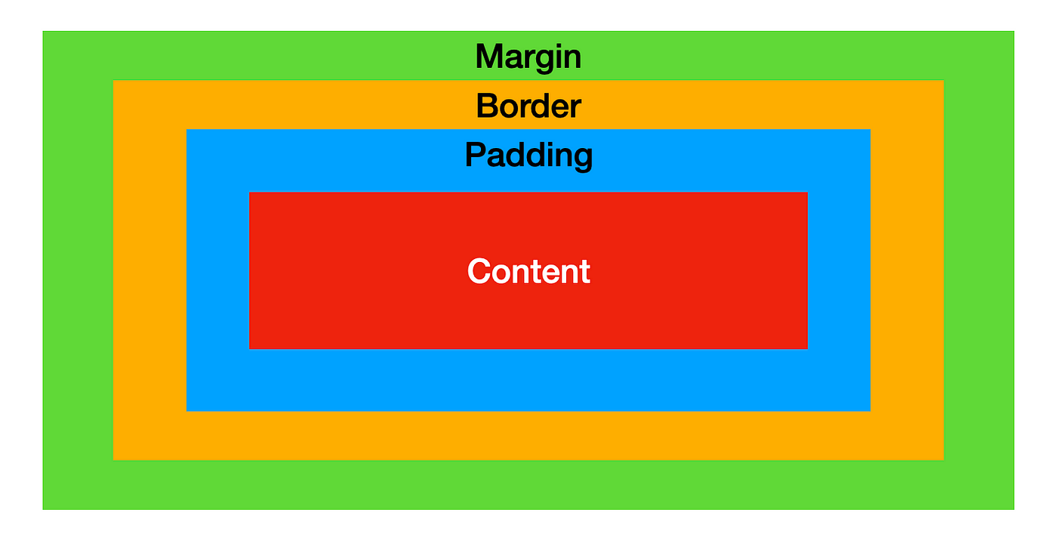
Box Model

Slide 57
Padding
Padding is used to create space around an element's content, inside of any defined borders.

Slide 58
Border
Border properties allow you to specify the style, width, and color of an element's border.

Slide 59
Margin
Margin properties are used to create space around elements, outside of any defined borders.

Slide 60
Use Google Fonts
https://fonts.google.com/

Slide 61
Student Signup Form

Slide 62
Agenda - Class 29 April 2023
1. Understanding VCs &
2. What and Why we need github ?
3. Install git & Config. our git
4. Git commands

Slide 63
Understanding Version Control System
VCs helps in managing changes code over time.
Helps in tracking and managing different versions of our code collaborate with other developers.
Examples of VCs :-
1. Git
2. Subversion (SVN)
3. Mercurial

Slide 64
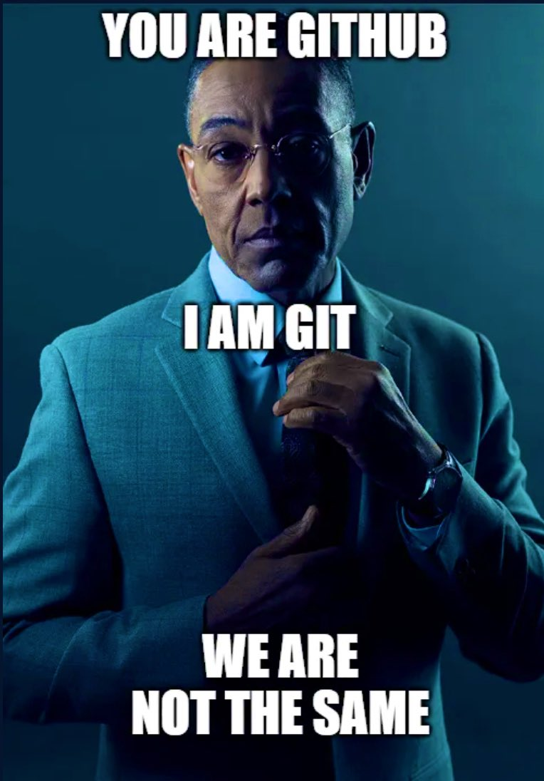
Understanding Git
1. Git is a distributed version control system.
2. Git and Github not SAME.

Slide 65
Agenda - Class 09 May 2023
Display
Position
Box Model
Handling Overflow

Slide 66
Display
display:inline
display:block
display:inline-block
display:float
display : none
display : hidden

Slide 67
Position
position : static
position : fixed
position : sticky
position : relative
position : absolute

Slide 68
Overflow
Overflow : hidden
Overflow : auto
Overflor : scroll

Slide 69
Agenda - Class 10 May 2023
Text Styling
Text-Shadow
Box-Shadow
Background-Image
Building Wedding Landing Page

Slide 70
Agenda - Class 11 May 2023
Complete Flex
Gradients
Building Linkedin Layout

Slide 71
Flex
Properties on Flex Container
Display : flex
Flex-wrap : wrap
Justify-content
Align-items
Gap
Properties on Flex Items
Order
Flex-grow - This defines the ability for a flex item to grow if necessary.
Flex-shrink - This defines the ability for a flex item to shrink if necessary.
Flex-basis - This defines the default size of an element before the remaining space is distributed.

Slide 72
Gradients
Linear-gradient
Radial-gradient
Repeating-radial-gradient

Slide 73
Agenda - Class 12 May 2023
CSS Combinators
Box-sizing:border-box
Z-index
Doubts
Discuss Next Week Plan

Slide 74
CSS Combinators
Descendant Selectors - It can be used to select child, grandchild, great-grandchild, great-great-great child, etc.
Div ul li a
Child Selectors - Selects all elements that are the children of a specified element.
Div > a
Adjacent Sibling Selectors - Used to select an element that is directly after another specific element.
Div + p
General Sibling Selectors - Selects all elements that are next siblings of a specified element
Div ~ p

Slide 75
Box-Sizing
Box-sizing:border-box
box-sizing: border-box; on an element, padding and border are included in the width and height.

Slide 76
Z-index
Z-index tells you the stack order of an element.

Slide 77
Agenda - Class 15 May 2023
ALL About Animation

Slide 78
Agenda - Class 16 May 2023
Different types of Units in CSS ( %, vh, vw, em, rem, px )
Pseudo Elements & Classes
Opacity Property

Slide 79
Pseudo-classes (:)
Pseudo itself means false, unreal, or fake
Used for styling element.

Slide 80
Pseudo-elements (::)
Pseudo elements are visible elements on a web page that aren’t “in the DOM” or created from HTML,
Used for styling specified parts of an element
Style the first letter, or line, of an element Insert content before, or after, the content of an element.
::first-line pseudo-element
::first-letter Pseudo-element
::before pseudo-element ( used to insert some content before the content of an element )
::after pseudo-element ( used to insert some content after the content of an element.

Slide 81
Agenda - Class 17 May 2023
Transform Property
Responsive Screens & Media Queries

Slide 82
Agenda - Class 18 May 2023
Responsive Screens & Writing Media Queries

Slide 83
Agenda - Class 19 May 2023
Grid
Grid Container Property
Grid Item Property

Slide 84
What is GRID
Two-dimensional layout system for creating rows and columns.
Flexbox is also a very great layout tool, but its one-directional flow
Grid Container
Grid Items

Slide 85
Grid-Template-Columns & Grid-Template-Rows
GTC - Defines the number of columns in your grid layout.
GTR - Defines the number of rows in your grid layout.
Also we can define the width of each row and column.
grid-template-columns: 1fr 1fr 1fr 1fr 1fr;
grid-template-rows: 600px 100px 100px 600px 100px 100px;
Fr units - Divide the available space in a layout.

Slide 86
Row-Gap & Column Gap
Row-Gap - Defines gap between two rows
Column-Gap - Defines gap between two columns
row-gap: 100px;
column-gap: 50px;

Slide 87
Justify-items & Align-Items ( Grid-Container Property )
Justify-items - Used to align the grid items along the horizontal axis.
Align-items - Used to align the grid items along the vertical axis.
justify-items: center; /* start or end or stretch */
align-items: center; /* start or end or stretch */

Slide 88
Justify-self & Align-self ( Grid-Item Property )
Justify-Self - Used to align a specific grid item along the horizontal axis.
Align-Self - used to align a specific grid item along the vertical axis.
justify-self: center; /* left or right */
align-self: center; /* start or end */

Slide 89
Grid-column-start & Grid-column-end
Used to display the starting and ending of an grid-item in along X- axis.
grid-column-start: 2;
grid-column-end: 5;
Grid-row-start & Grid-row-end
Used to display the starting and ending of an grid-item in along Y- axis.
grid-row-start: 1;
grid-row-end: 3;

Slide 90
Building Video Gallery

Slide 91
Agenda - Class 22 May 2023
Intro to Programming
Intro to JavaScript
Variables
Data Types

Slide 92
Intro to Programming
Programming helps in speeding up the input and output processes in a machine.
It is important to automate, collect, manage, calculate, and analyze the processing of data and information accurately.
Programming helps create software and applications that help computer and mobile users in daily life

Slide 93
Intro to Javascript
JavaScript is a scripting or programming language.
Javascript can help in frontend, backend and mobile app development.
That allows you to implement complex features on web pages.
Every time a web page does more than just sit there and display static information.
Displaying timely content updates, interactive maps, animated 2D/3D graphics, scrolling video jukeboxes, etc.

Slide 94
Programming Languages basic
Program runs in RAM
Program in running state is called Process.
Keywords - Reserved words for programming
languages.
Variables - used for storing some values.
Data-Types

Slide 95
Variables

Slide 96
Data-Types

Slide 97
Different Data-Types

Slide 98
Agenda - Class 23 May 2023
Repeating Yesterday’s Class
Understanding Symbol and Reference
JavaScript - Dialog Boxes
String and its functions
Control Flow (if-else) (if-else if-else)

Slide 99
Reference Variables

Slide 100
JavaScript - Dialog Boxes
Alert Dialog Box
An alert dialog box is mostly used to give a warning or alert message to the users
Confirm Dialog box
A confirmation dialog box is mostly used to take user's consent on any option. It displays a dialog box with two buttons: OK and Cancel.
Prompt Dialog box
The prompt dialog box is very useful when you want to pop-up a text box to get user input.

Slide 101
String and its functions

Slide 102
Control Flow (if-else) (if-else if-else)

Slide 103
Agenda - Class 01 June 2023
Understanding Function
Purpose
How to write
How to call
How to define
How to pass arguments and return value.
How Code Executes in Javascript ?
Memory Phase
Code execution phase

Slide 104
Purpose of Function, Why We need it
Reusability: Functions allow us to write modular and reusable code. Instead of writing the same code multiple times, we can define a function that performs a specific task and call it whenever needed.
Code organization: Functions help in structuring code by breaking it down into logical units. By organizing related code into functions, it becomes easier to locate and update specific functionality.
Readability and maintainability: Functions improve the readability and maintainability of code by breaking it into smaller, self-contained units.
Abstraction: Functions provide a way to abstract complex operations or algorithms into simpler, more manageable units.

Slide 105
function function-name(parameter1 , parameter2,..)
{
// Code to be executed
// Optionally we can return value from function
}

Slide 106
Here's an example of a simple JavaScript function that calculates the sum of two numbers:
function calculateSum(a, b) {
var sum = a + b;
return sum;
}
In this example, the function is named calculateSum, and it takes two parameters a and b. Inside the function, the sum of a and b is calculated and stored in the sum variable. Finally, the sum value is returned using the return statement.

Slide 107
Now Let’s call the Function
var result = calculateSum(5, 3);
console.log(result); // Output: 8
In this case, calculateSum(5, 3) is called, and the result is assigned to the result variable. The console.log statement prints the value of result, which is 8 in this example.

Slide 108
We can pass any number of argument to function.
But we should accept as well as parameter in function.

Slide 109
What are the different thing we can pass to function
Primitives: You can pass primitive data types such as numbers, strings, booleans, and symbols to a function.
Objects: You can pass objects as arguments to a function. Objects can include arrays, functions, and other objects.
Arrays: You can pass arrays as arguments to a function. Arrays can contain any type of data, including other arrays and objects.
Functions: In JavaScript, functions are treated as first-class citizens, which means you can pass functions as arguments to other functions. This is known as "function as an argument" or "callback" concept.

Slide 110
Let’s Make a function for All

Slide 111
How Code Executes in JavaScript
In JavaScript, code execution follows a specific sequence of steps. Let's discuss the general flow of code execution and the concepts of memory and code execution phases.

Slide 112
First Phase - Parsing
When a JavaScript program is run, the first phase is parsing.
The JavaScript engine reads the entire script and analyzes its syntax to create the Abstract Syntax Tree (AST).
This process identifies the structure and grammar of the code.

Slide 113
Second Phase - Memory Allocation
Very Important Phase.
The JavaScript engine allocates memory for variables, functions, and other resources used by the program.
It creates a global execution context that represents the global scope.

Slide 114
Third Phase - Code Execution
Code Execution: JavaScript code is executed in a single-threaded manner.
Meaning that only one piece of code is executed at a time.
The execution starts from the global execution context and proceeds line by line, following the order of statements.

Slide 115
Fourth Phase - Execution Stack
JavaScript uses a data structure called the execution stack, also known as the call stack.
To keep track of the execution order. Whenever a function is called, a new execution context is created and pushed onto the stack.
When a function completes its execution, its execution context is popped off the stack, and control returns to the calling context.

Slide 116
Fifth Phase - Garbage Collection
JavaScript uses automatic memory management known as garbage collection.
It periodically checks for variables, objects, and other resources that are no longer referenced by the program and frees up memory occupied by them.

Slide 117
Agenda - For Today
Understanding Scoping
Understanding let, var, const
Understanding Second and Third Phase
Block & Lexical Scope
Understanding Hoisting

Slide 118
What is Scoping ?
Scoping in JavaScript refers to the visibility and accessibility of variables, functions, and objects within different parts of your code.
JavaScript has two main types of scope:
Global Scope ( Memory Manager and Code Execution Manager )
Functional Scope ( Memory Manager and Code Execution Manager )

Slide 119
Global, Functional or Local Scope
Global Scope: Variables or function declared outside of any function or block have global scope. They are accessible from anywhere in your code, including other functions and blocks.
Local Scope or functional Scope: Variables declared inside a function or block have local scope. They are only accessible within that specific function or block and not accessible outside of it.

Slide 120
Let’s understand Var
In JavaScript, var, let, and const are used to declare variables, but they have some differences in terms of scope and behavior.
var: It is the oldest way to declare variables in JavaScript.
Variables declared with var are function-scoped or globally scoped.
This means that a variable declared with var inside a function is accessible only within that function.
while a variable declared with var outside of any function is accessible throughout the entire program.

Slide 121
Let’s understand Let
let: Introduced in ECMAScript 6 (ES6).
let allows block-scoping of variables.
Variables declared with let are limited in scope to the block (enclosed within curly braces) in which they are defined.

Slide 122
Let’s understand Const
const: Also introduced in ES6.
const is used to declare variables that are block-scoped but with a value that cannot be reassigned.
The variable must be assigned a value at the time of declaration, and once assigned, its value cannot be changed.

Slide 123
Memory Phase
In this Phase, JavaScript engine allocates memory for variables, functions, and other resources used by the program.
During this phase, Engine only check or search for let, var, const and function keyword and assigned memory to them.
All variables will be assigned undefined as a value during this phase.

Slide 124
Code Execution Phase
Now Check the Fourth Phase - Execution Stack
In this Phase, JavaScript engine actually execute the code line by line.
Now when it reassigned same variables with value (which was undefined in memory phase).

Slide 126
Agenda - Class 05 June 2023
Understanding Execution Context
Understanding Lexical Scoping
Understanding Hoisting

Slide 127
Execution Context
Execution Context is an internal data structure used to manage the execution of code.
It includes variables, functions, and other contextual information necessary for the code to be executed.
When JS Parsing phase one is done. Following things happens:-
Global Execution Context created
Memory Phase starts
Code Execution phase starts.
Now every time a function is called in JavaScript, a new execution context is created.

Slide 128
Lexical Scope
Simple Definition
Lexical Scope = Local Scope + Parent Scope + Global Scope

Slide 129
Let’s Check Examples of Lexical Scopes

Slide 130
Hoisting in Javascript
Hoisting is a behavior in JavaScript where variable and function declarations are moved to the top of their respective scopes during the compilation phase, before the code is executed (Code execution).
To understand hoisting, let's consider two scenarios:
Variable Hoisting
Function Hoisting

Slide 131
var myVariable; // Declaration is hoisted
console.log(myVariable); // undefined
myVariable = 'Hello, hoisting!'; // Assignment
console.log(myVariable); // Hello, hoisting!
—----------------------------------------------------
console.log(myVariable); // undefined
var myVariable = 'Hello, hoisting!'; // Assignment
console.log(myVariable); // Hello, hoisting!

Slide 132
myFunction(); // Hello, hoisting!
function myFunction() {
console.log('Hello, hoisting!');
}
In this example, we call myFunction before its actual declaration in the code.
Again, JavaScript hoists the function declaration to the top, making it available for invocation even before the declaration itself.

Slide 133
Final Remark on Hoisting
Unlike variable declarations, function declarations are entirely hoisted.
Including the function body. Therefore, we can call the function before or after its declaration, and it will work correctly.

Slide 134
Agenda - Class 06 June 2023
Intro To DOM
How to Select Elements using DOM
How to Update Elements using DOM
How to Create Elements using DOM
How to remove Elements using DOM

Slide 135
Introduction to DOM
"DOM" stands for Document Object Model.
It is a programming interface that represents the structure and content of a web page as a tree-like structure.
The DOM provides a way for programs, such as web browsers, to interact with and manipulate the elements and properties of an HTML.
By using the DOM, developers can dynamically update the content of a web page, respond to user interactions, create new elements, change styles, and perform various other operations on web documents.

Slide 136
How to Select Elements using DOM
To select elements using the DOM, We can use various methods and selectors provided by
the DOM API.
Here are some commonly used methods:
getElementById: This method selects an element based on its unique ID
attribute.
Example : -
const element = document.getElementById('elementId');
getElementsByClassName: This method selects elements and return a collection of
elements ( Array ) based on their class name.
Example :-
const elements = document.getElementsByClassName('className');

Slide 137
How to Select Elements using DOM
getElementsByTagName: This method selects elements and return a collection of
elements ( Array ) based on their tag name.
Example : -
const elements = document.getElementsByTagName('tagName');
querySelector: This method selects the first element that matches a specific CSS selector.
Example : -
const element = document.querySelector('selector');
querySelectorAll: This method selects all elements and return a collection of elements
( Array ) that match a specific CSS selector and
returns them as a NodeList.
Example : -
const elements = document.querySelectorAll('selector');

Slide 138
How to Update elements using DOM
Updating the element's text content:
You can update the text content of an element using the textContent property.
Modifying the element's HTML content:
If you want to update the HTML content of an element, you can use the innerHTML property.
Modifying element styles:
You can update the CSS styles of an element by accessing its style property and modifying individual style properties.

Slide 139
How to Create Element using DOM
We can use the createElement method provided by the DOM API.
Here's an example of how to create and append a new element to the DOM:
// Create a new element
const newElement = document.createElement('tagName');
// Set text content or HTML content, if needed
newElement.textContent = 'Text content';
// or
newElement.innerHTML = '<p>HTML content</p>';
// Append the new element to an existing element in the DOM
const parentElement = document.getElementById('parentElementId');
parentElement.appendChild(newElement);

Slide 140
Agenda - Class 07 June 2023
How to remove Elements using DOM
Intro To Web Events
Exploring different Events
All Different Ways of writing Events

Slide 141
Intro to Web Events
In the web world, events refer to actions or occurrences that take place within a web application or on a webpage.
These events can be triggered by user interactions, such as clicking a button, submitting a form, or hovering over an element, or they can be triggered by the browser or other external factors.
Web events are typically handled using JavaScript, which allows developers to write code that responds to specific events and performs some actions.
When an event occurs, the associated event handler function is executed, allowing developers to define custom behaviors and interactions.

Slide 142
Different Types of Events
Click: Triggered when a user clicks on an element.
Double-click: Triggered when a user double-clicks on an element.
Mouseover: Triggered when the user's mouse pointer enters an element.
Mouseout: Triggered when the user's mouse pointer leaves an element.
Contextmenu: Triggered when the user right-clicks on an element to open the context menu.
Keydown: Triggered when a key is pressed down on the keyboard.
Keyup: Triggered when a key is released on the keyboard.
Keypress: Triggered when a key is pressed and released on the keyboard.
Load: Triggered when a webpage or an element finishes loading.
Unload: Triggered when a webpage is being unloaded or the user navigates away from the page
Scroll: Triggered when the user scrolls the webpage or an element.
Resize: Triggered when the browser window or an element is resized.
Focus: Triggered when an element gains focus, typically associated with form inputs.
Blur: Triggered when an element loses focus.

Slide 143
Important Thing & Industry Standard
addEventListener();
This is the most commonly used method to attach an event listener to an element. It takes two parameters: the event type and a callback function to be executed when the event occurs.

Slide 144
Let’s Check Examples…

Slide 145
const button = document.querySelector('button');
button.addEventListener('click', function() {
console.log('Button clicked!');
});
OR
const button = document.querySelector('button');
button.onclick = function() {
console.log('Button clicked!');
};

Slide 146
const element = document.querySelector('.element');
element.onmouseover = function() {
console.log('Mouse over the element!');
};
element.onmouseout = function() {
console.log('Mouse left the element!');
};

Slide 147
const element = document.querySelector('.element');
element.onkeydown = function() {
console.log('key pressed');
};
element.onkeyup = function() {
console.log('key released);
};

Slide 148
Agenda - Class 09 June 2023
Hoisting
Nested Functions. How to Call and How to return
Very Important Topic - Closures

Slide 149
Nested Functions
In JavaScript, you can define a function inside another function, which is referred to as a nested function.
A nested function has access to variables and parameters of its outer function, as well as global variables.

Slide 150
Closures
Closures are an important concept that allows functions to remember and access variables which were (it means parent may be destroyed) present in lexical scope (local+parent+global/ from the outer [enclosing] scope), even after the outer function has finished executing. (Refer 12-closure.js file)
A closure is created whenever an inner function references variables from its outer function.
Closures are useful in scenarios like implementing private variables and functions, creating function factories

Slide 151
Let’s See Some Example now

Slide 152
Callbacks
A callback function is a function passed into another function as an argument, which is then invoked inside the outer function to complete some kind of routine or action.

Slide 153
Agenda - Class 13 June 2023
Intro to BOM
Different BOM Objects
Browser Storage
Different browser Storage

Slide 154
BOM - Browser Object Model
The Browser Object Model (BOM) is the core of JavaScript on the web.
The BOM provides you with objects that expose the web browser’s functionality.
It represents the browser window and its components as objects, providing methods and properties to control and access various aspects of the browser environment.

Slide 155
Window Object
The top-level object in the BOM hierarchy is the window object, which represents the browser window or tab.
It provides properties and methods to control the browser window, navigate to different URLs, and access other objects within the BOM.
Writing → window.alert() and just alert same thing.
Alert, confirm, prompt, setTimeout, setInterval, clearTimeout, clearInterval, open, close
innerWidth, document.body.clientWidth

Slide 156
2. Navigator Object
The navigator object is part of the Browser Object Model (BOM). It provides information about the user's browser and device.
It includes various properties and methods to access and retrieve browser-related information.
navigator.userAgent, navigator.language, navigator.platform,
navigator.geolocation.getCurrentPosition(successCallback, errorCallback)
navigator.onLine, navigator.connection, navigator.vibrate(pattern),
navigator.mediaDevices.getUserMedia(constraints):

Slide 157
3. Location Object
The location object represents the URL of the current web page.
It allows you to read and modify the URL, navigate to different pages, and retrieve information like the hostname, pathname, and query parameters.
Location.href, location.protocol, location.hostname, location.pathname,
location.search, location.reload(), location.assign(url)

Slide 158
4. History Object
The history object provides methods to navigate backward and forward within the browser's history.
You can use it to programmatically control the browser's navigation.
Such as going back to the previous page or redirecting the user to a specific page in their history.
history.back(), history.forward(), history.go(2)

Slide 159
5. Screen Object
The screen object represents the user's screen or monitor.
It provides properties to retrieve information about the screen's dimensions, color depth, and other display-related details.
screen.width, screen.height, screen.availwidth, screen.availheight
screen.orientation.type, screen.orientation.angle

Slide 160
Let’s Understand Browser Storage
Session Storage
Local Storage
IndexedDB

Slide 161
Browsers can store temporary data using various mechanisms.
Examples :-

Slide 162
Session Storage
Stores data for a single browsing session.
The data is available only within the current session and is cleared when the browser is closed.
Limit is max 5 MB.
Example :-

Slide 163
Local Storage
Stores data that persists even after the browser is closed and reopened.
This data is available across browser sessions. Limit is up to 10 megabytes.
Example:-

Slide 164
Agenda - Class 14 June 2023
Understanding Web Architecture & Backend
Understanding HTTP
Understanding JSON
Understanding AJAX, XHR

Slide 165
HTTP - Hypertext Transfer Protocol
Application-layer protocol for transmitting hypermedia documents, such as HTML.
It was designed for communication between web browsers and web server.
HTTP follows a classical client-server model.
A client opening a connection to make a request, then waiting until it receives a response.

Slide 166
Most Important Point for HTTP
HTTP is a stateless protocol, meaning that the server does not keep any data (state) between two requests.
Request and Response Model.

Slide 167
HTTP Methods and How to Request
The different operations ( create, delete, update & delete ) that can be done with HTTP.
The commonly used methods are :-
GET (retrieve a resource)
POST (create a new resource)
PUT/PATCH (update an existing resource)
DELETE (remove a resource).

Slide 168
HTTP Response and Status Code
HTTP response refers to the message sent by a server to a client in response to an HTTP request.
When a client (such as a web browser) sends an HTTP request to a server, the server processes the request.
And then generates an HTTP response, which is then sent back to the client.
Response format can JSON or XML.

Slide 169
Status Code or Response Code
HTTP response codes indicate whether a specific request has been successfully completed.
Responses are grouped in five classes :-
Informational responses (100 – 199)
Successful responses (200 – 299) IMP - 200, 201
Redirection messages (300 – 399) IMP - 301, 302
Client error responses (400 – 499) IMP - 400, 401, 403, 404
Server error responses (500 – 599) IMP - 500, 503

Slide 170
200 - OK
201 - Successfully Created
301 - Moved Permanently
302 - Moved Temporarily
400 - Bad Request
401 - Unauthorized
404 - Not Found
500 - Internal Server Error
503 - Service unavailable

Slide 171
HTTP Headers
Req. Header & Res Header

Slide 172
HTTP headers are additional pieces of information sent by the
client or the server along with an HTTP request or response.
These headers provide instructions, metadata, or control information related to the request or response.
Some common types of headers include:
Content-Type: Specifies the media type of the content sent in the request body.
Authorization: Contains credentials to authenticate the client with the server.
Content-Type: Specifies the media type of the response content.
Date: Specifies the date and time the message was sent.
Connection: Indicates whether the connection should be kept alive or closed after the request/response.

Slide 173
Intro to JSON
JSON data is represented as key-value pairs.
JavaScript Object Notation (JSON) is a standard text-based format for representing structured data based on JavaScript object syntax.
It is commonly used for transmitting data in web applications.
Ex:- sending some data from the server to the client, so it can be displayed on a web page, or vice versa.

Slide 174
How to write JSON
JSON data is represented as key-value pairs.
Here's a basic example of a JSON object:
{
"name": "John Doe",
"age": 25,
"city": "New York"
}

Slide 175
Let’s Check Some API Calls in Network Tab

Slide 176
Agenda - Class 15 June 2023
Understanding meaning Synchronous.
Understanding meaning Asynchronous.
Discuss AJAX.
To make an Ajax request ( XHR - GET & POST Request )

Slide 177
Synchronous in Javascript
Synchronous also know as blocking code.
As its base JavaScript language is synchronous.
Synchronous means the code runs in a particular sequence of instructions given in the program.
Each instruction waits for the previous instruction to complete its execution.
Due to this nature of synchronous programming, sometimes important task get blocked due to some previous instructions, which causes a delay in the user interface.
Example of important tasks : - Uploading Video, Downloading songs etc.

Slide 178
Asynchronous in Javascript
Asynchronous also know as non-blocking code.
Asynchronous code execution allows to executes next instructions immediately and doesn't block the flow because of previous instructions.
Example -:
console.log('First');
setTimeout(() => console.log('Second'), 2000);
console.log('Third');

Slide 179
AJAX -(Asynchronous JavaScript and XML)
Ajax is a technique that allows you to update parts of a web page without needing to reload the entire page.
It enables asynchronous communication between the browser and the server, allowing for dynamic content updates.
To mak st, you typically use :-
XMLHttpRequest (XHR) object
jQuery's Ajax functions or the Fetch API.
Or utilize a higher-level library framework ( Axios )

Slide 180
XHR - XMLHttpRequest
XMLHttpRequest (XHR) object is provided by web browsers as part of the browser's.
It’s built-in functionality for handling HTTP requests and interacting with servers.
XMLHttpRequest (XHR) is an API in web development, That allows client-side scripts to send HTTP or HTTPS requests to a server and retrieve data.
It enables asynchronous communication between the client and the server.
Facilitating the exchange of data mostly in JSON format.

Slide 181
Let’s write code to call api using XHR

Slide 182
Agenda - Class 16 June 2023
Intro to Asynchronous javascript
What is inside core Javascript Engine ?
What is Javascript Runtime ?
Event Loop
Revise XHR and Understand Try-Catch ( Quickly )

Slide 183
Intro to Asynchronous javascript
As its base JavaScript language is synchronous language.
Beauty of JS is how it handles Asynchronous programming.
JavaScript handles asynchronous programming through various mechanisms, including :-
Callbacks
Promises
Async/Await.

Slide 184
We will discuss all these three mechanism in detail 1 by 1.

Slide 185
Callbacks
A callback function is a function passed into another function as an argument.
Which is then invoked inside the outer function to complete some kind of routine or action.
Callbacks are also used to handle asynchronous operations.
A callback function is passed as an argument to an asynchronous function.
And it gets executed when the asynchronous operation completes.

Slide 186
Now Let’s Check Example of asynchronous callback

Slide 187
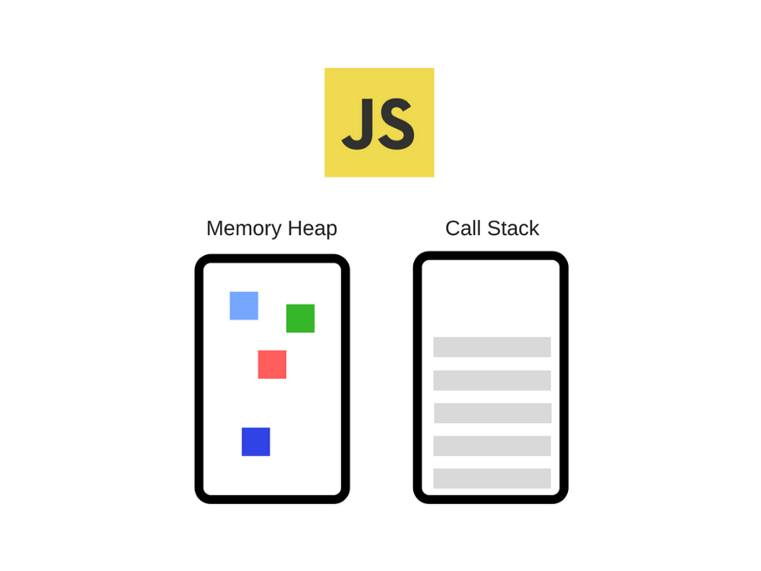
Javascript Engine

Slide 188
What is Inside Javascript Engine ?
Memory Heap:
The memory heap is the portion of the engine's memory where objects, variables, and function closures are stored.
It manages the allocation and deallocation of memory during program execution.
Call Stack:
The call stack keeps track of the currently executing functions and their context.
It allows the engine to manage function calls, track the order of execution, and handle function returns.

Slide 189
What is Inside JS Runtime?
Javascript Engine.
Web APIs (Browser Runtimes):
In browser-based JavaScript runtimes, additional features are provided through Web APIs.
These APIs enable interaction with the following things : -
Document Object Model (DOM)
handling network requests (AJAX, Fetch API)
manipulating HTML5 canvas
managing web storage (localStorage, sessionStorage)
handling events, and more
Examples of Web APIs include the DOM API, XMLHttpRequest, and the
Web Audio API.

Slide 190
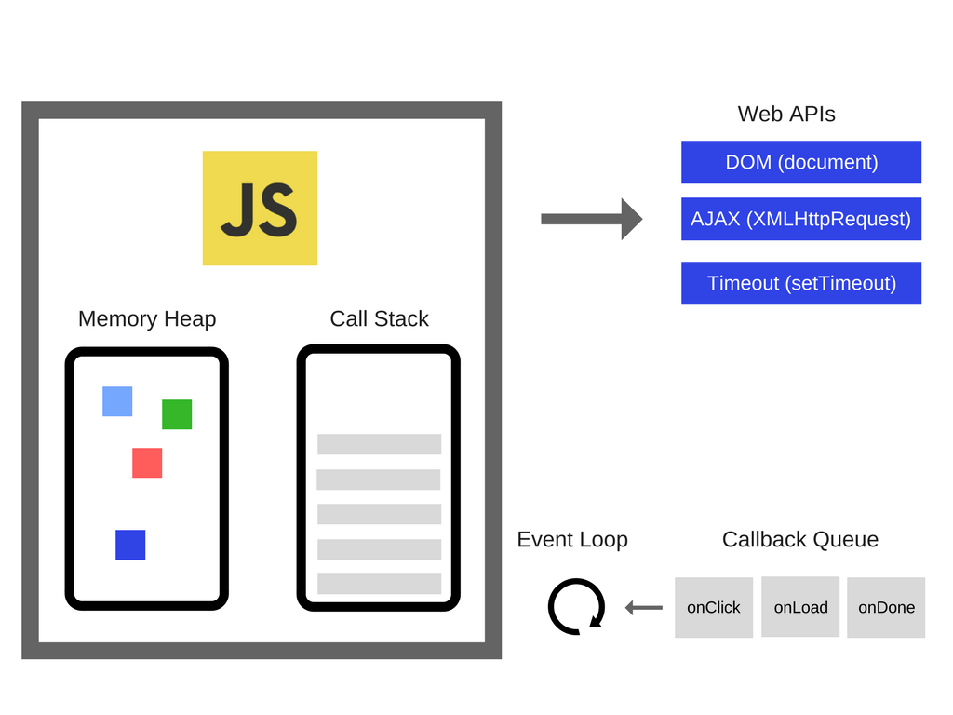
Javascript Runtime

Slide 191
Event Loop
Event Loop:
The event loop is a critical part of the JavaScript runtime, especially in environments like web browsers and Node.js.
It manages the execution of asynchronous operations, such as :-
Browser Web APIs.
It ensures that these operations are processed efficiently and in the correct order.

Slide 193
Try-Catch-finally
For gracefully handling runtime or dynamic errors we should be use try-catch blocks.
The code in the try block is executed first.
And if it throws an exception, The code in the catch block will be executed.
The code in the finally block will always be executed.

Slide 194
Agenda - Class 21 June 2023
Food delivery Example
Promise Hell
How async-await helps you ?
Intro to Object Oriented Programming.

Slide 195
Async - Await
Async/await is a feature introduced in ECMAScript 2017 (ES8) that provides a more concise and readable way to work with asynchronous code.
Async/await simplifies asynchronous programming by making it look more like synchronous code.
It enhances code readability and makes error handling more straightforward.

Slide 196
Here and when to async keyword
async function fetchData() {
// Asynchronous code goes here
}

Slide 197
Here and when to await keyword
The await keyword can only be used within an async function only.
We can use the await keyword to pause the execution of the function until a promise is resolved or rejected.
It allows you to assign the resolved value of a promise to a variable or perform further operations.

Slide 198
Remember, async functions always return a promise.
You can use .then() and .catch() to handle the result of an async function if you prefer working with promises directly.

Slide 199
Object Oriented Programming
Object-oriented programming (OOP) is a programming paradigm that organizes code into objects, which are instances of classes.
It provides a way to structure and design software applications by focusing on objects that contain both data and behavior.
In OOP, objects are the fundamental building blocks, and they interact with each other through methods, properties, and messages

Slide 200
Class and Object
Class:
A class is a blueprint or template that defines the properties and behaviors (methods) of objects.
It encapsulates data and functions related to a particular concept or entity.
Object:
An object is an instance of a class.
It represents a specific occurrence of the class, possessing its own unique set of data values and behavior.

Slide 201
Agenda 22 June 2023
Intro to Jquery
Why it’s important and how to use it ?
Selecting, Updating, Creating, Removing Elements
How to handle events in Jquery
Different Jquery functions

Slide 202
hide(): Hides the selected element.
show(): Shows the selected element.
toggle(): Toggles between hiding and showing the selected element.
fadeIn(): Fades in the selected element.
fadeOut(): Fades out the selected element.
fadeToggle(): Toggles between fading in and fading out the selected element.
slideUp(): Slides up (hides) the selected element.
slideDown(): Slides down (shows) the selected element.
slideToggle(): Toggles between sliding up and sliding down the selected element.
addClass(): Adds one or more CSS classes to the selected elements.
removeClass(): Removes one or more CSS classes from the selected elements.
toggleClass(): Toggles between adding and removing a CSS class from the selected elements.
attr(): Gets or sets the value of an attribute for the selected elements.

Slide 203
html(): Gets or sets the HTML contents of the selected element.
text(): Gets or sets the text content of the selected element.
val(): Gets or sets the value of form elements, such as input fields.
css(): Gets or sets CSS properties for the selected elements.
on(): Attaches an event handler function to the selected elements.
off(): Removes an event handler function from the selected elements.
each(): Iterates over a set of selected elements and performs a function on each one.

Slide 204
Agenda 30 June 2023
Why we should focus more on async JS ?
Example - Navigator Object & Discuss Real time
Examples ( We will be using live recording Project )
Revise Callbacks + Examples
Revise Promise + Examples
Revise Async-Await + Examples

